Slide 1
Feature engineering
It is the most important technique used in creating the machine learning models.it is the basic term used to cover many operations that are performed on the variables i.e. features.to fit them into the algorithm.
It helps in increasing the accuracy of the model thereby enhances the result of the predictions.
The prepared models by feature engineering are performed better than basic machine learning models.

Slide 2
Techniques of Feature engineering
1)Imputation
2)Encoding

Slide 3
Imputation
Imputation is a technique used for replacing the missing data with some substitute value to retain most of the data/information of the dataset.
Missing values can be handled by deleting the rows or columns having null values.
Or the statistical approach of handling missing values uses the mean,median or mode imputation

Slide 4
Feature encoding
Feature encoding is the conversion of categorical features to numeric values as machine learning models cannot handle the text data directly.
Types of feature encoding are
1.Label encoding
2.One hot encoding

Slide 5
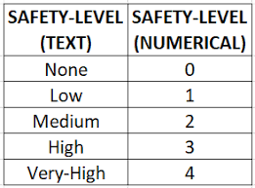
Label encoding
Label Encoding refers to converting the labels into a numeric form so as to convert them into the machine-readable form.
It is the most important pre-processing step for the structured dataset in supervised learning .

Slide 6
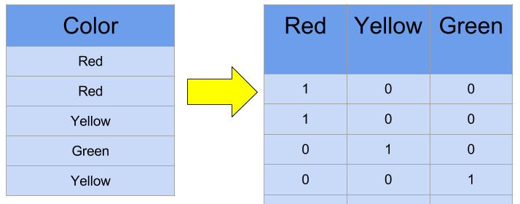
One hot encoding
To overcome the disadvantage of label encoding ,we can use one –hot encoding
It is processed in 2 step
1)Splitting of categories to different columns.
2)Put 0 for others and 1 as an indicator for the appropriate column.

